Slide 1
CRAFT SE-2
Problem - Implementing the module that keeps track of the all time top 5 scores.

Slide 2
Index
Assumption
Information
Approach
Flow Diagram
Architecture
Schema

Slide 3
Assumptions
All time high scores is similar to the Olympics leaderboard.
Considered the Leaderboard will stores at max top 500. (generally games like pubg, valorant, clash royale maintains leaderboard of top 1000 based on global/region and season).
Instead of File for topic I have created an API which randomly generates the data.
Instead of Redis currently created a Min Heap for in Memory storage.

Slide 4
Information
Database - MySQL
Framework - Spring Boot.
/leaderboard/v1/global - returns all time top 5 players Info.
/leaderboard/v1/add - working as a consumer whenever data is submitted process.
In Memory - Used Heaps.
Notes:
(disclaimer: because of time constraint i used heaps. I was learning Spring Boot & working on the task simultaneously)

Slide 5
Approach
Created a Priority Queue of size K will work as a min heap. (k = 0,1,2,3, ……)
Priority Queue will work as a cache and will stores the top k all time scorers.
Whenever player score is received then LeaderBoard service is called which will perform the business logic, validation & dumps the data to DB & cache.
If user wants data of topk users form leaderboard it will directly returns the values from In memory data.
Notes:
Other approach merging k sorted arrays

Slide 6
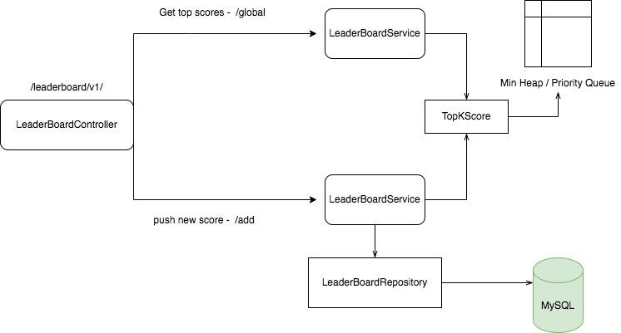
Flow Diagram

Slide 7
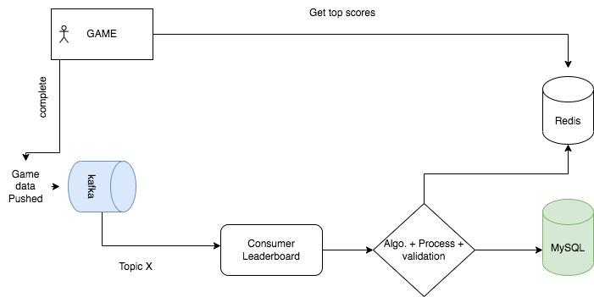
System Design - Architecture

Slide 8
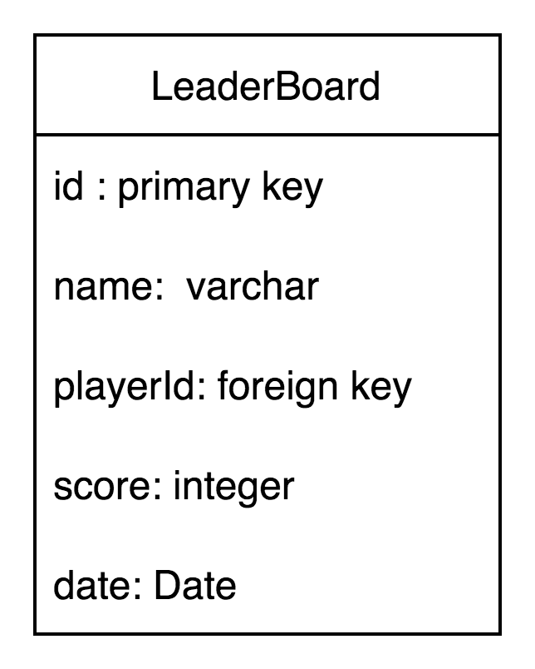
SCHEMA - leaderboard
As per the current requirement :
Id, name, playerId, score, date (score,date) - indexing
New Schema if new game type introduced and region based leaderBoard:
Id, name, playerId, score, date, location, gameType
Indexing will be done on score, date, location, gametype

